Slide 1

Testing Trends Using Boundless Analytics and Permutation Tests
By Fauzan Amjad

Slide 2
The Dataset
We’re provided a rich dataset with 20,000 columns with 7 columns of categorical variables.
Each row represent a buyer
The categorical variables are beer, day, location, soft drinks, sweets, wine, and snacks.
Our goal is to find patterns or trends and then run tests to see if their significant.
We’ll first use Boundless Analytics to find these potential trends
We will then test to see if these trends are statistically significant

Slide 3
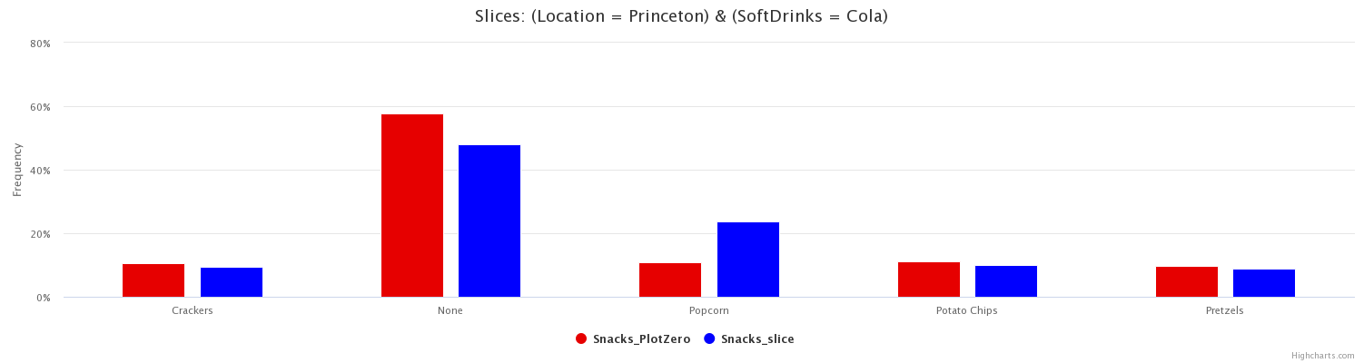
Boundless Analytics Plot
Attribute -> Snacks
Blue Slice -> Location = Princeton and SoftDrinks = Cola

Slide 4
Analyzing the Boundless Analytics Plot
I set the attribute I wanted to analyze to be snacks.
Boundless analytics made approximately 438 plots; however, we’ll predominantly be toning on the data regarding popcorn.
With the general population (the entire dataset), the frequency of of popcorn is approximately 10.95%.
When we subset the population to only include people who live in Princeton and to people who got Cola as their soft drink, the frequency of popcorn becomes 23.78%
That is more than double the frequency of popcorn of the general population.

Slide 5
Null and Alternate Hypothesis
Null Hypothesis
Buyers of Cola who live in Princeton buy popcorn at the same frequency as the general population.
Alternate Hypothesis
Buyers of Cola who live in Princeton do not buy popcorn at the same frequency as the general population.

Slide 6
Bonferroni Correction
The issue with using 0.05 as our p-value threshold is that the more hypotheses that we potentially test out, the more of a chance we will come across a rare event.
In a scenario like this where we keep 0.05 as our threshold, we could actually incorrectly reject the null hypothesis.
In order to Bonferroni correct, we have to divide 0.05 by the number of tests we can potentially form.
Boundless analytics gives us 438 plots and each plot has 5 graphs .
We can run 2190 tests!
Our new threshold is 2.28 * 10^(-5)
0.05/2190

Slide 7
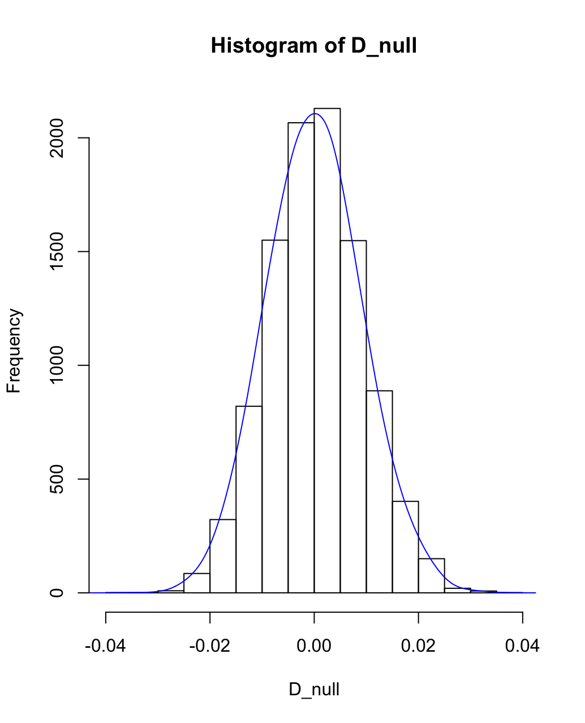
Permutation Test
library(readr)
data <- read_csv("Desktop/HomeworkMarket.csv")
data$bar <- 0
data$slice <- 0
data[data$Snacks == "Popcorn",]$bar <- 1
data[data$Location == "Princeton" & data$SoftDrinks == "Cola",]$slice <- 1
PermutationTestSecond::Permutation(data,"slice", "bar", 10000, "0", "1" )

Slide 8
Analysis of Results
From our permutation test, we got a p-value of 0.
The p-value tell us the likelihood how we could observe the current values under the assumption that the null hypothesis is true.
Our p-value is under our Bonferroni corrected significance level.
Conclusion
We reject the null hypothesis.
We accept the alternate hypothesis: Buyers of Cola who live in Princeton do not buy popcorn at the same frequency as the general population.

Slide 9
Exploring the Data More
We just just accepted the alternate hypothesis: Buyers of Cola who live in Princeton do not buy popcorn at the same frequency as the general population.
What would happen if we would only subset the data with people with people who live in Princeton? What if we did the same with people who buyed Coca-Cola?
We already know, based on the Boundless Analytics plots, that
These are tests we can further explore.

Slide 10
New Hypotheses
Permutation Test #2
Null Hypothesis: Buyers who live in Princeton buy popcorn at the same frequency as the general population.
Alternate Hypothesis: Buyers who live in Princeton do not buy popcorn at the same frequency as the general population.
Permutation Test #3
Null Hypothesis: Buyers of Cola buy popcorn at the same frequency as the general population.
Alternate Hypothesis: Buyers of Cola do not buy popcorn at the same frequency as the general population.
We’ll use the same Bonferroni Correction.

Slide 11
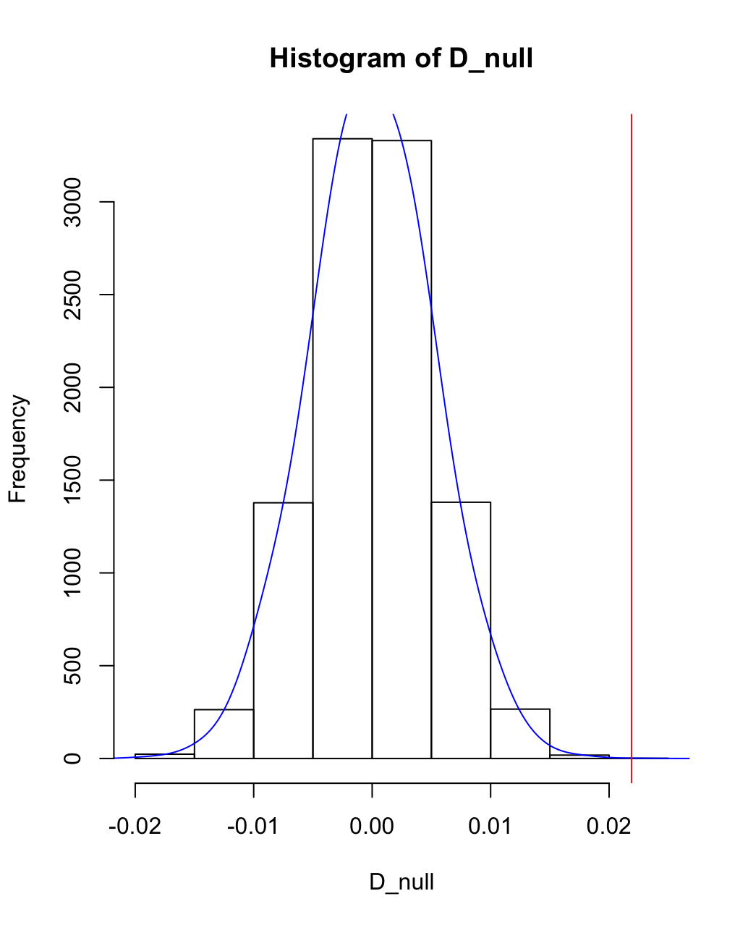
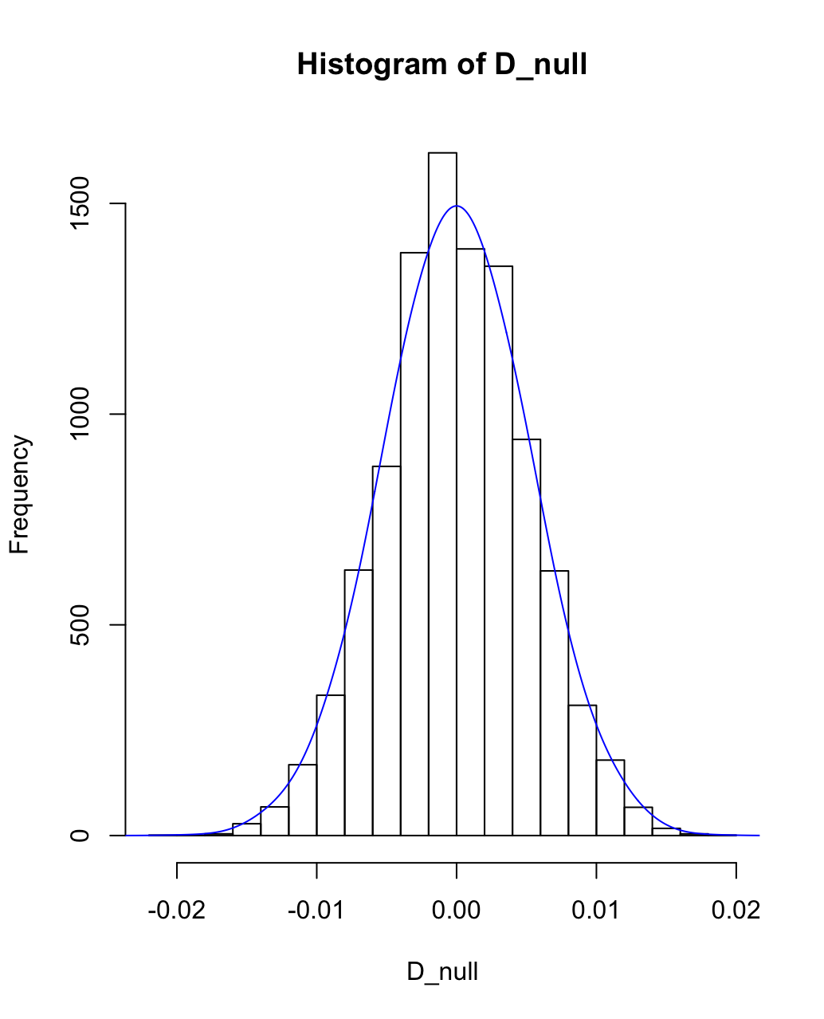
Permutation Test #1
Permutation Test #2
data$bar <- 0
data$slice <- 0
data[data$Snacks == "Popcorn",]$bar <- 1
data[data$Location == "Princeton",]$slice <- 1
PermutationTestSecond::Permutation(data,"slice", "bar", 10000, "0", "1" )
data$bar <- 0
data$slice <- 0
data[data$Snacks == "Popcorn",]$bar <- 1
data[data$SoftDrinks == "Cola",]$slice <- 1
PermutationTestSecond::Permutation(data,"slice", "bar", 10000, "0", "1" )

Slide 12
Conclusions From Our Permutation Tests
Permutation #2
The p-value came out to 10^(-4). This is greater than our Bonferroni corrected p-value.
We fail to reject the null hypothesis: Buyers who live in Princeton buy popcorn at the same frequency as the general population.
Permutation #3
The p-value came out to 0. This is less than our Bonferroni corrected p-value.
We reject the null hypothesis.
We accept the alternate hypothesis: Buyers of Cola do not buy popcorn at the same frequency as the general population.

Slide 13
Suggestions Based on Our Tests
In the Princeton location, if someone buys Cola as their soft drink, a significant portion of them will be getting popcorn with it is as well - a higher frequency than the general population..
If someone is buying Cola as their soft drink, irrespective of where the location might be, they a significant portion of them will be getting popcorn with it as well – a higher frequency than the general population.

